Slide 1
Software Engineering and Architecture
Pattern Fragility

Slide 2
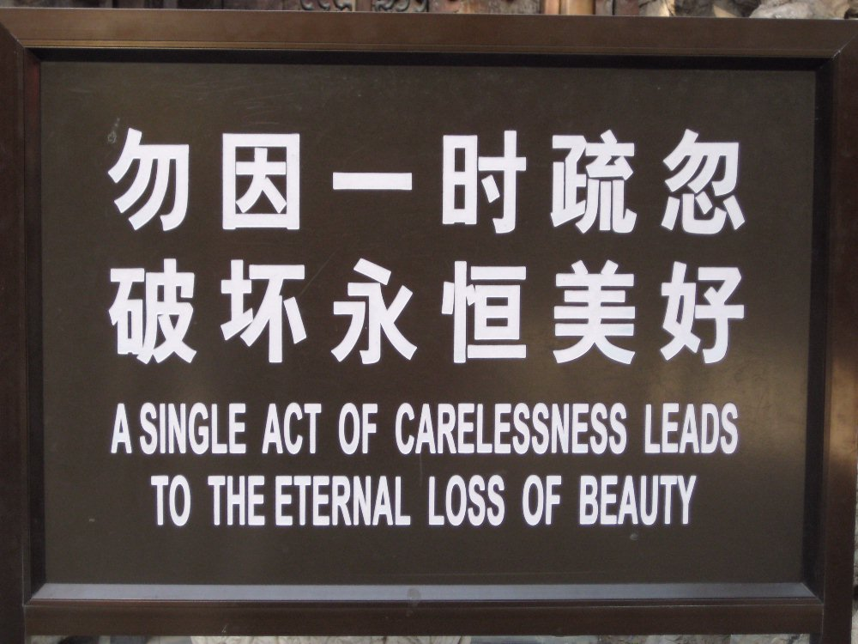
Advice
Forbidden city, Beijing.

Slide 3
Why Patterns?
Design patterns organize and structure code in a particular way.
Static: Arrangement of classes/interfaces
Dynamic: Assignment of responsibility, interaction patterns
Why:
Because I get some benefits from doing so…
Bottom line:
Patterns are means to a goal, not the goal itself

Slide 4
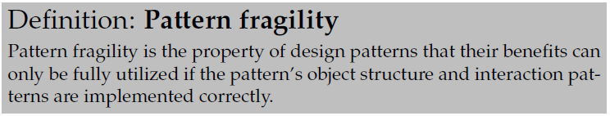
Patterns Are Code
However, patterns are defined in code, and if I code wrong I “amputate” the pattern. I get all the liabilities and none of the advantages.
Warstory:
COT case: Reusable search component’s deadline was forced. Additional staff added. A design pattern based, highly decoupled, design was utterly destroyed in a week.

Slide 5
Example: Strategy

Slide 6
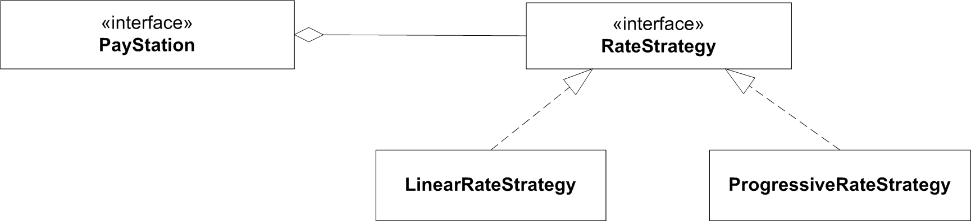
Strategy
Responsibilities must be served by concrete behaviour in objects...

Slide 7
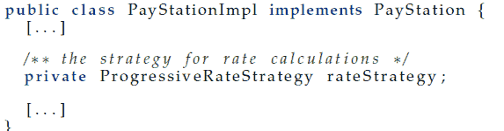
Pitfall 1: Declaration of Delegates
1. Do not even think of using class names in declarations!
Why is the following change a disaster

Slide 8

Keypoint 1

Slide 9
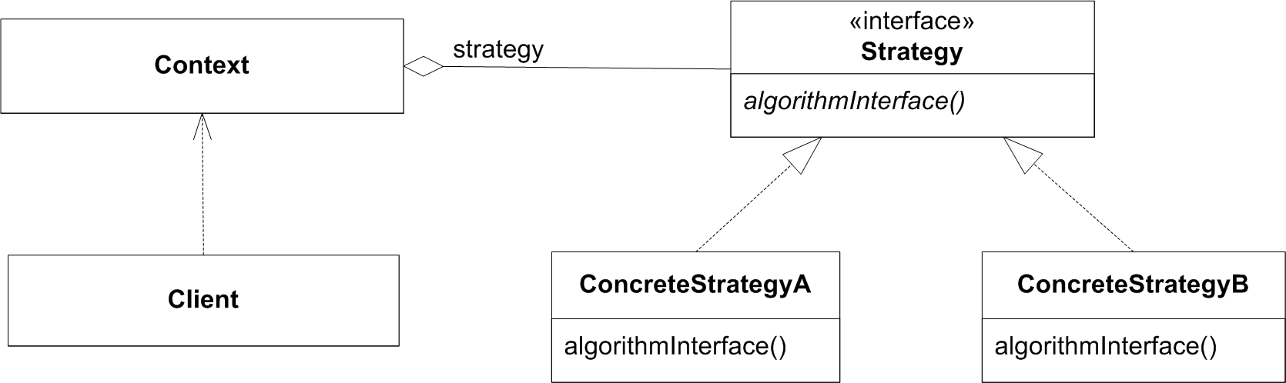
Pitfall 2: Binding in the Right Place
Loose coupling is fine, but we have to couple the objects together eventually.
It is important that the binding is made
in the right place
as few places as possible (optimally 1!)
Many possibilities for Strategy:
Why not here???

Slide 10
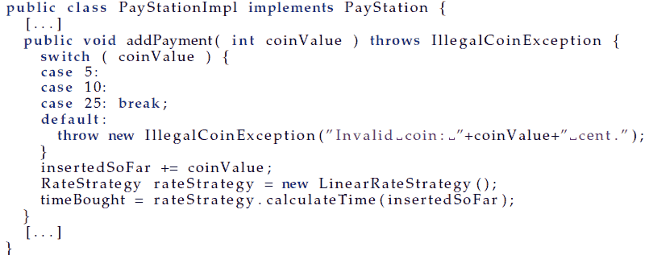
Binding in the Wrong Place
Binding in the Context object:
Will not break any tests for Alphatown!

Slide 11
Consequence
What is the consequence?
I got all the pattern’s liabilities
more interfaces and classes and objects to overview
And none of the pattern’s benefits
high coupling
no variability at all!

Slide 12

Advice
Keypoint
In Strategy, this is normally the Client role.
Note again:
Automated tests that test the full suite of products will detect this defect.
A manual testing effort much focused on a specific product variant will probably not...

Slide 13
Relation to Other Patterns
Abstract Factory is a creational pattern. Its purpose in life is to define bindings. Thus, the factory is often the right place to make bindings.
In State it is actually often the ConcreteState objects that define the ‘next state’ of the state machine. Thus it is more common that ConcreteState objects directly create state objects.

Slide 14
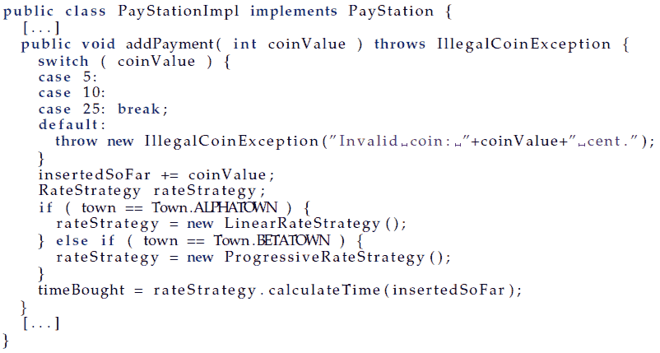
Concealed Parameterization
Assume: Previous binding survived.
Later: “Why does Betatown not work any more?
I need to fix it, and fix it fast!”

Slide 15

Advice
Keypoint

Slide 16
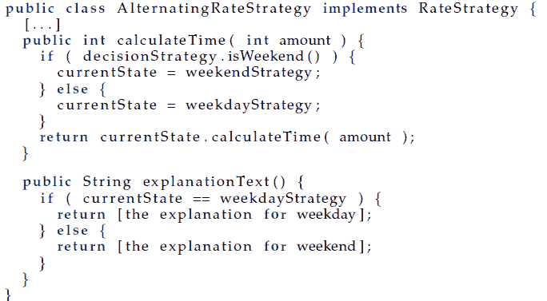
Responsibility Erosion
Software changes its own requirement.
New (weird) request
Gammatown: Explain rate policy.

Slide 17
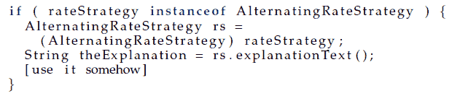
Consequences
Now, however, this strategy does not conform to the contract by the interface.
Solution: Move the method up into the RateStrategy interface.
But: I have now added a new responsibility. One that may not be cohesive.

Slide 18

Advice
Keypoint:
However, sometimes you do need to add more methods to the interface…
Strategy: some complex algorithms require methods, that the simpler variants do not have any use for

Slide 19
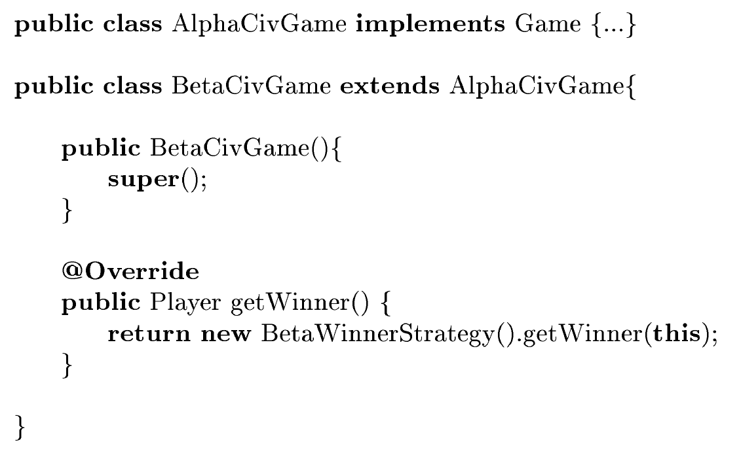
The polymorphic wrapping trap
From a mandatory hand-in

Slide 20
Summary
Take care at the implementation level!!!
It only takes a few “slip-ups” to completely destroy the intended benefits of a pattern!
Corollary: You do not learn patterns by reading a book or listening to me!
CODE! and reflect!



Slide 21
Summary
All your programmers must deeply understand the roles and protocols embodied in design patterns in order to keep the design intact.

